Slide 1
Department of Computer Science
Computer Security (CoSc 4171)

Slide 2
Course outline
Chapter I. Introduction
Chapter II. Basic cryptography
Chapter III. Security in conventional operating systems
Chapter IV. Database management systems security
Chapter V. Network security

Slide 3
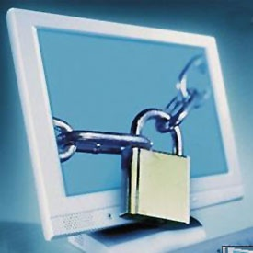
Chapter I Introduction
“The most secure computers are those not connected to the Internet and shielded from any interference”

Slide 4
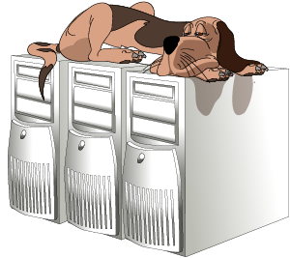
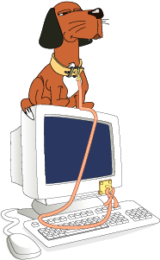
Definition
Computer security is about provisions and policies adopted to protect information and property from theft, corruption, or natural disaster while allowing the information and property to remain accessible and productive to its intended users.

Slide 5
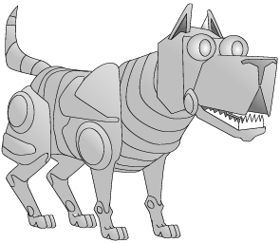
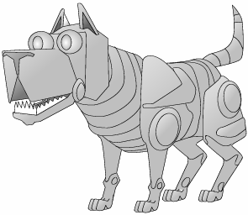
Definition:
Computer Security when there is connection to networks (Network security) on the other hand deals with provisions and policies adopted to prevent and monitor unauthorized access, misuse, modification, or denial of the computer network and network-accessible resources.
Not Sufficient!!
Internet

Slide 6
Computer Security Goals
Prevention of unauthorized disclosure of information
Confidentiality
Prevention of unauthorized modification of information
Prevention of unauthorized withholding of information or resource
Integrity
Availaibility

Slide 7
Definition cont…..
Security in general is about protection of assets. This implies that in order to protect our assets, we must know the assets and their values. Rough classification of protection measures includes:
Deterrence: creating an atmosphere intended to frighten intruders.
Prevention: to take measures to prevent the damage
Detection: when, how and who of the damage.
Reaction: to take measures to recover from damage.
Example of protecting voluble items at home from a burglar:
Deterrence: preparing rules and regulations.
Prevention: Locks on the door, guards, hidden places, …
Detection: Burglar alarm, guards, CCTV, …
Reaction: Calling the police, replace the stolen item, …

Slide 8
Definition cont……
Example of protecting a fraudster from using our credit card in Internet purchase
Prevention: Encrypt when placing order, perform some check before placing order, or don’t use credit card number on internet.
Detection: A transaction that you had not authorized appears on your credit card statement.
Reaction: Ask for new card, recover cost of the transaction from the insurance, the card issuer or the merchant

Slide 9
Definition cont…..
Security: The protection of computer assets from unauthorized access, use, alteration, degradation, destruction, and other threats.
Privacy: The right of the individual to be protected against intrusion into his personal life or affairs, or those of his family, by direct physical means or by publication of information.
Security/Privacy Threat: Any person, act, or object that poses a danger to computer security/privacy.

Slide 10

Computer Security and Privacy/Attacks
Categories of Attacks
Interruption: An attack on availability
Interception: An attack on confidentiality
Modification: An attack on integrity
Fabrication: An attack on authenticity

Slide 11
Computer Security and Privacy/Attacks
Categories of Attacks/Threats
Source
Destination
Normal flow of information
Attack
Interruption
Interception
Modification
Fabrication

Slide 12
Computer Security and Privacy/Vulnerabilities
Types of Vulnerabilities
Physical vulnerabilities (Ex. Buildings)
Natural vulnerabilities (Ex. Earthquake)
Hardware and Software vulnerabilities (Ex. Failures)
Media vulnerabilities (Ex. Disks can be stolen)
Communication vulnerabilities (Ex. Wires can be tapped)
Human vulnerabilities (Ex. Insiders)

Slide 13
Computer Security and Privacy/ Countermeasures
Computer security controls
Authentication (Password, Cards, Biometrics)
(What we know, have, are!)
Encryption
Auditing
Administrative procedures
Standards
Certifications
Physical Security
Laws

Slide 14
Computer Security and Privacy/ The Human Factor
The human factor is an important component of computer security
Some organizations view technical solutions as “their solutions” for computer security. However:
Technology is fallible (imperfect)
Ex. UNIX holes that opened the door for Morris worm
The technology may not be appropriate
Ex. It is difficult to define all the security requirements and find a solution that satisfies those requirements
Technical solutions are usually (very) expensive
Ex. Antivirus purchased by ETC to protect its Internet services
Given all these, someone, a human, has to implement the solution

Slide 15
Computer Security and Privacy/ The Human Factor
Competence of the security staff
Ex. Crackers may know more than the security team
Understanding and support of management
Ex. Management does not want to spend money on security
Staff’s discipline to follow procedures
Ex. Staff members choose simple passwords
Staff members may not be trustworthy
Ex. Bank theft

Slide 16
Computer Security and Privacy/ Physical Security
Physical security is the use of physical controls to protect premises, site, facility, building or other physical asset of an organization.
Physical security protects your physical computer facility (your building, your computer room, your computer, your disks and other media).

Slide 17
Threats and vulnerabilities
Natural Disasters
Fire and smoke
Climate: Heat, Direct sun or Humidity
Hurricane, storm, cyclone
Earthquakes
Water
Electric supply
Lightning
Solution
Avoid having servers in areas often hit by Natural Disasters!

Slide 18
Computer Security and Privacy/ Physical Security
Threats and vulnerabilities …
People
Intruders
Thieves
People who have been given access unintentionally by the insiders
Employees, contractors, etc. who have access to the facilities
External thieves
Portable computing devices can be stolen outside the organization’s premises
Loss of a computing device
Mainly laptop

Slide 19
Individual Assignment (10%)
Read about these security attack related keywords. Study about one of these keywords and write a 10 page (maximum) summary of your findings including any recorded history of significant damages created by these attacks.
Send your report by email in word format before 15 days (Use your names as the file name). second page of your report.
Brute Force Attack Buffer Overflow Cookie Injection Cookie Poisoning DNS Poisoning DoS and DDoS Attack Eavesdropping HTTP Tunnel Exploit ICMP and UDP Flood Logic Bomb Malware Attack Packet Sniffing Ping of Death | Server Spoofing Session Hijacking Smurf Attack Spamming Scam and Phishing Spoofing Attack SQL Injection SYN Attack Teardrop Traffic Analysis Trojan Horses, Viruses, and Worms War Dialing Wire Tapping

Slide 20
Security policies
A security policy is a formal statement of the rules by which people who are given access to an organization's technology and information assets must abide.
Purposes of a Security Policy
The main purpose of a security policy is to inform users, staff and managers of their obligatory requirements for protecting technology and information assets.
The policy should specify the mechanisms through which these requirements can be met.
Another purpose is to provide a baseline from which to acquire, configure and audit computer systems and networks for compliance with the policy.
Therefore, an attempt to use a set of security tools in the absence of at least an implied security policy is meaningless.
Notes:
The Detail of security policies are discussed in the last chapter of this course.

Slide 21
Sources of Security Threats
Design Philosophy:- since of the Internet and cyberspace in general was based on an open architecture work in progress philosophy.
Weaknesses in Network Infrastructure and Communication Protocols
Rapid Growth of Cyberspace
The Growth of the Hacker Community
Vulnerability in Operating System Protocol:- every OS comes with some security vulnerabilities. In fact many security vulnerabilities are OS specific. Hacker look for OS-identifying information like file extensions for exploits.
The Invisible Security Threat (the Insider effect): - research data from many reputable agencies consistently show that the greatest threat to security in any enterprise is the guy down the hall.
Social Engineering: -
Physical Theft
Notes:
Three-way handshake opens the port in the server, an intruder can enter the system because while one port remains open, the server can still entertain other three-way handshakes from other clients that want to communicate with it (this situation is true both in TCP and UDP transport protocols).

Slide 22
Security Threat Motives
Based on the FBI’s foreign counterintelligence mission, security threats broadly categorized into the following groups:
Terrorism: - electronic terrorism is used to attack military installations, banking, and many other targets of interest based on politics, religion, and probably hate. Cyber-terrorism is not only about obtaining information; it is also about instilling fear and doubt and compromising the integrity of the data.
Military Espionage
Economic Espionage
Vendetta/Revenge
Hate (National Origin, Gender, and Race)
Notoriety (ill fame)
Greed

Slide 23
Security Threat Motives cont….
Targeting the National Information Infrastructure: - Activities may include the following
Denial or disruption of computer, cable, satellite, or telecommunications (tele) services;
Unauthorized monitoring of computer, cable, satellite, or tele systems;
Unauthorized disclosure of proprietary or classified information stored within or communicated through computer, cable, satellite, or tele systems;
Unauthorized modification or destruction of computer programming codes, computer network databases, stored information or computer capabilities; or
Manipulation of computer, cable, satellite, or tele services resulting in fraud, financial loss, or other federal criminal violations.
Ignorance: - it happens when a novice in computer security stumbles (upsets) on an exploit or vulnerability and without knowing or understanding it uses it to attack other systems.

Slide 24
Security Threat Management
It a technique used to monitor an organization’s critical security systems in real-time to review reports from the monitoring sensors such as the intrusion detection systems, firewall, and other scanning sensors.
These reviews help to reduce false positives from the sensors, develop quick response techniques for threat containment and assessment, correlate and escalate false positives across multiple sensors or platforms, and develop intuitive analytical, forensic, and management reports.
To secure company resources, security managers have to do real-time management.
Real-time management requires access to real time data from all network sensors.
Notes:
Example: false negative in case of un-updated anti-virus software for scanning a system.

Slide 25
End of Chapter I
Chapter II

